Slide 1





Insta-A 2.0
Walkthrough
This is the sole and exclusive property of HDFC Life. October 12, 2021

Slide 2
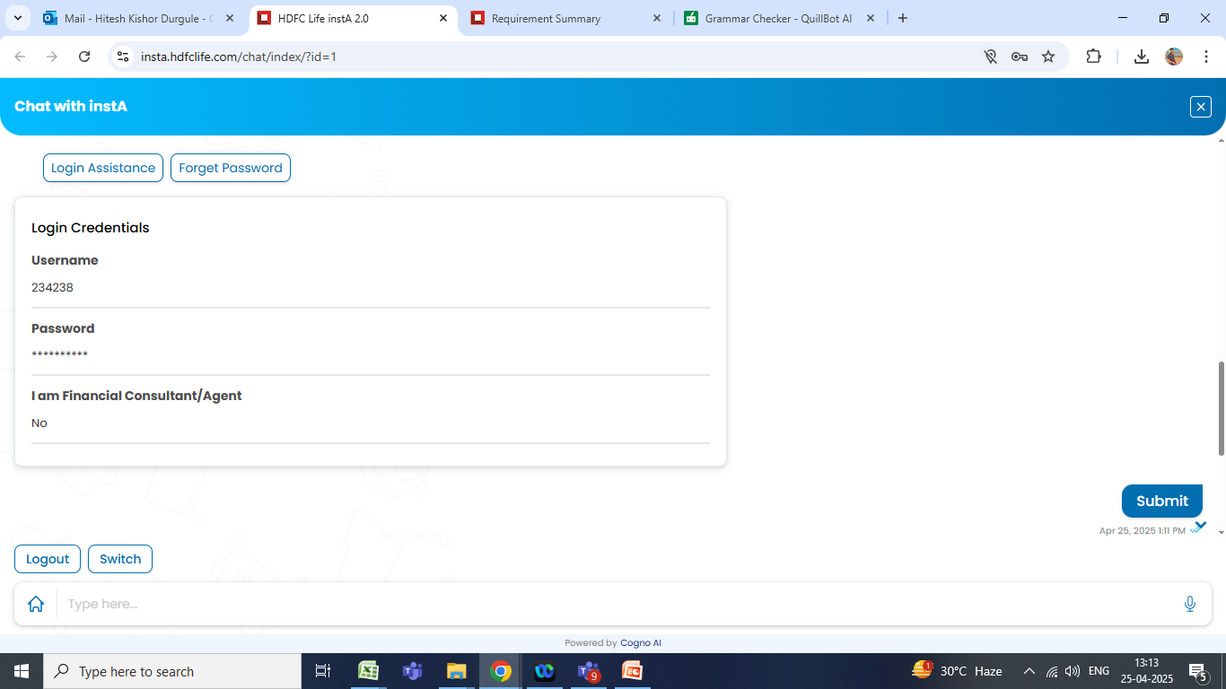
Login Screen
Username is the official email id
Password:Hdfc@2025$

Slide 3
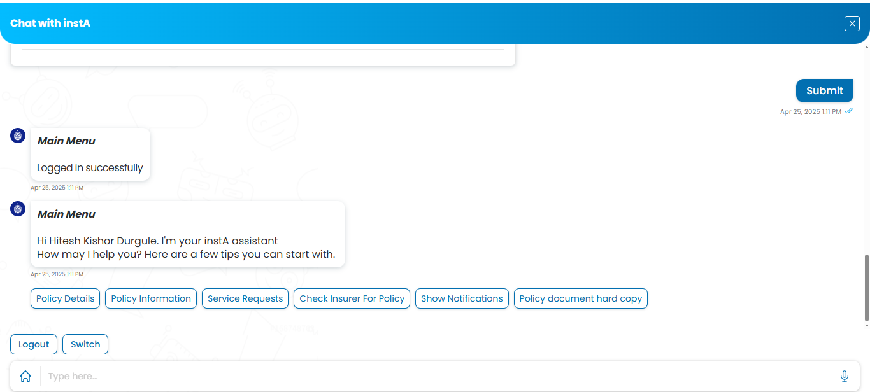
Logged Screen

Slide 4
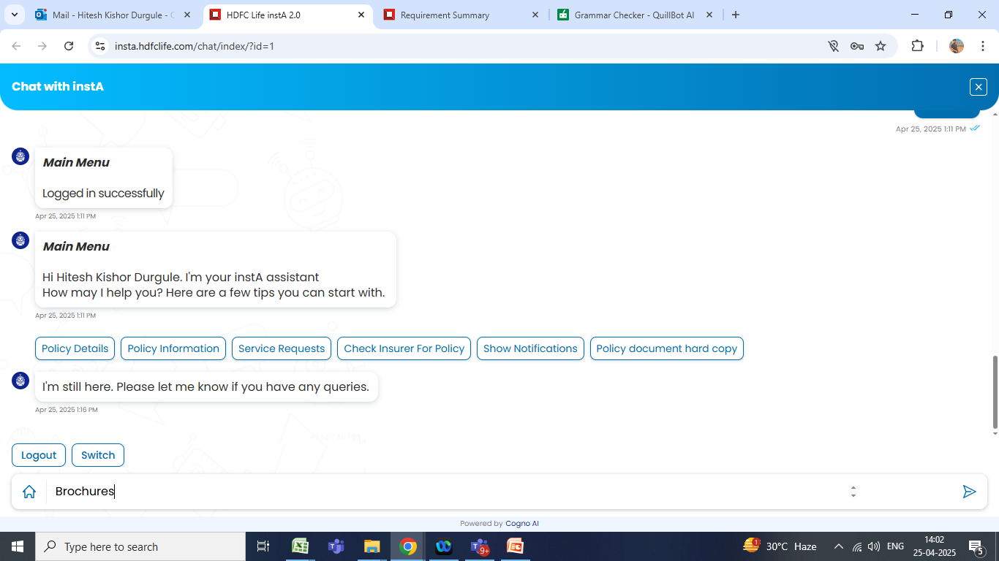
Ex.1 To Download Brochures

Slide 5
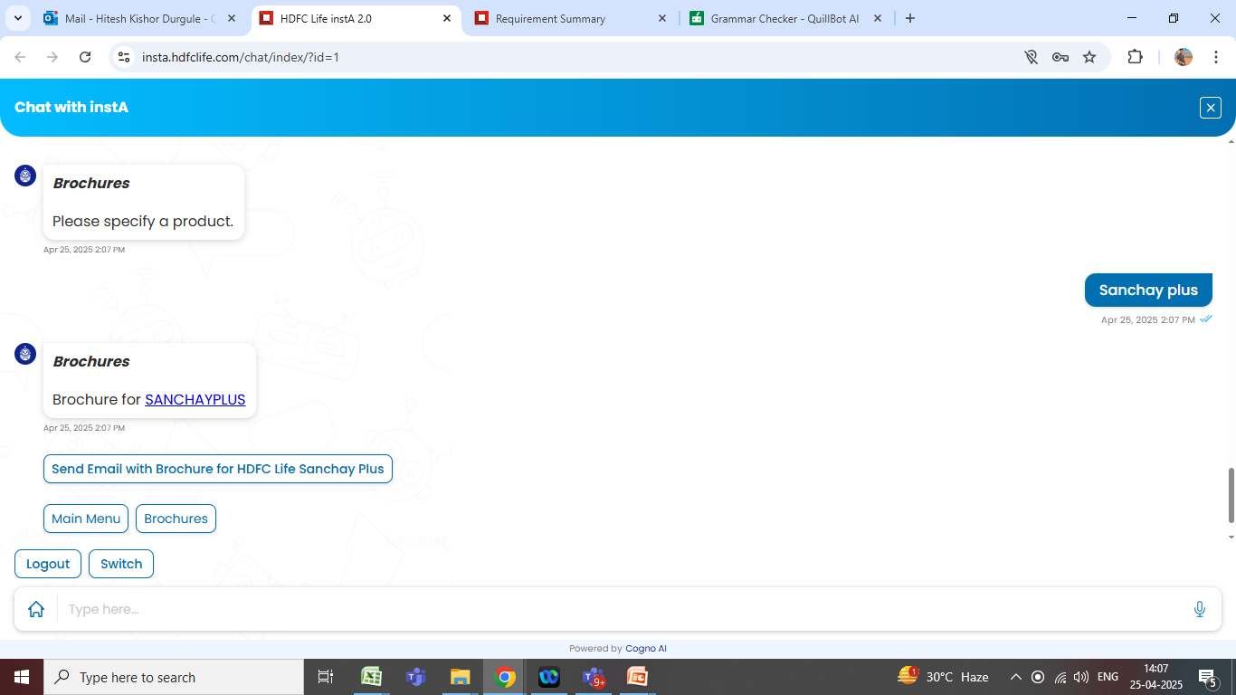
Ex.1 To Download Brochures
Just write the plan name
You will get the output.

Slide 6
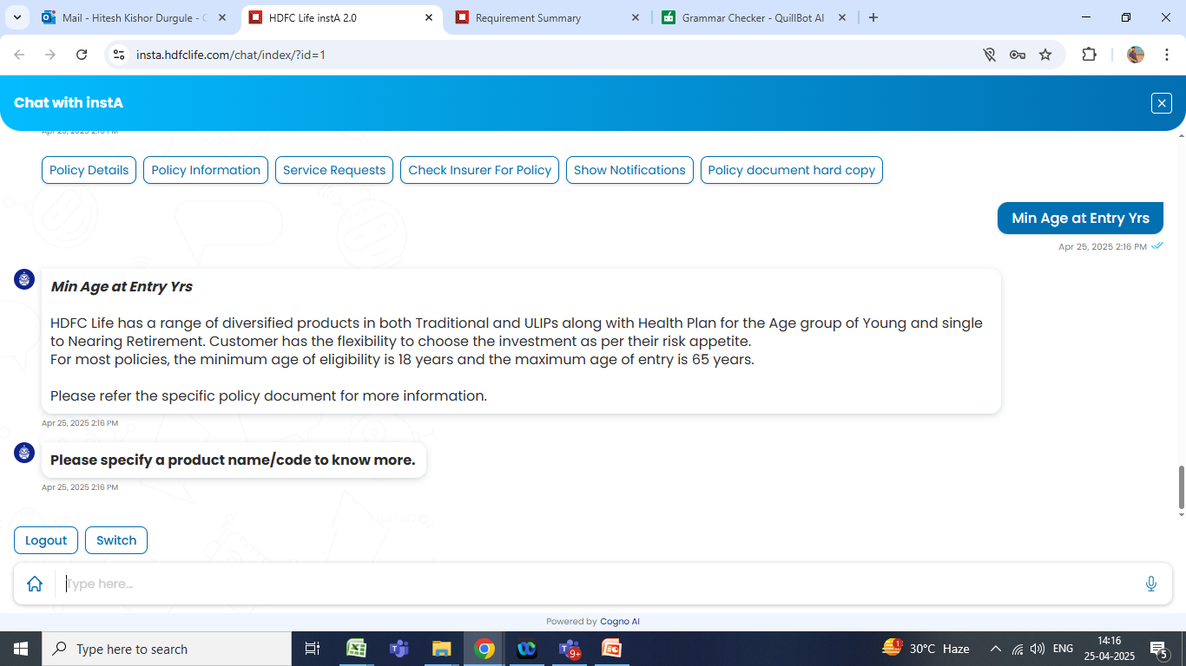
Ex.2 To check the entry age
To check Minimum entry age

Slide 7
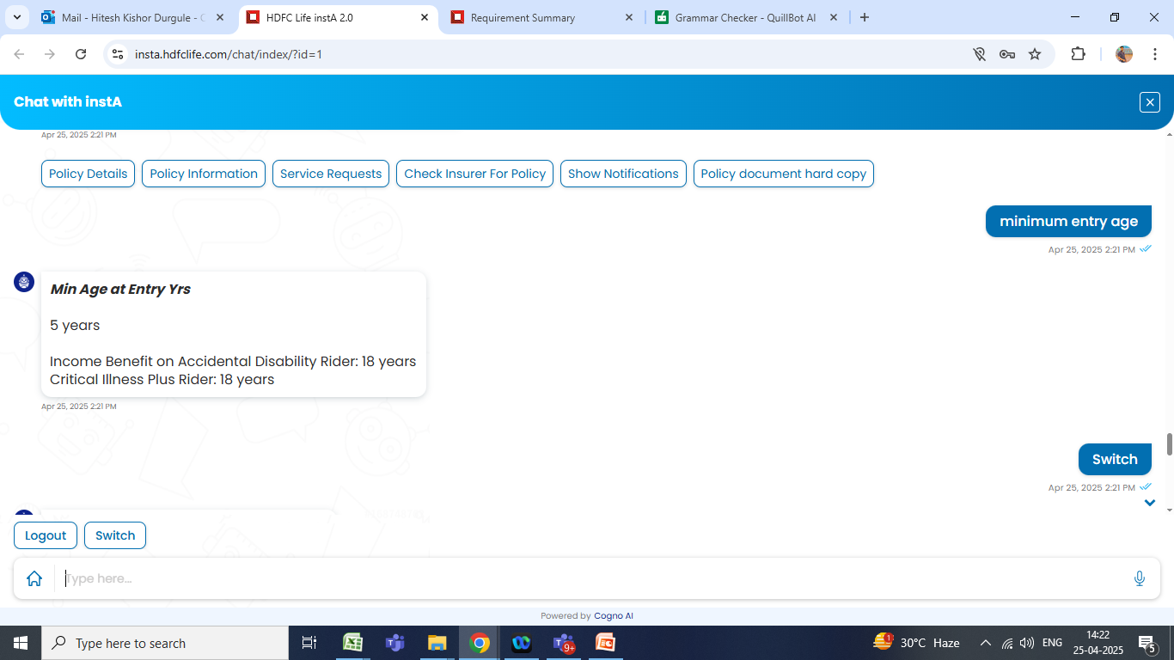
Ex.2 To check the entry age
To check Minimum entry age
You will get the output.

