Slide 1


Slide 2

Presenting…
Low-Cost
Structure
Market Linked Returns
Premium Reduction Flexibility
Convenience
Free Switches
Tax Efficiency
Life Cover

Slide 3
Product Features
Wider Reach
Available for Minors, NRIs, Housewives & Students too!
Diverse Basket of
Funds
Facility to diversify your portfolio into the basket of funds available in different Asset classes i.e., Equity, Balanced and Debt category along with Index Funds
Unlimited Free
Switches
Switch units from one fund to another as per your priorities
Unlimited switches available free of cost from 24 Funds to choose from.
Partial and Systematic Withdrawal Benefit
Make partial withdrawals from your Fund up to 20% of your Fund Value free of cost or You can opt for Regular Payouts or DIY option through SWP.
Premium Redirection
Change the proportion of the fund allocation in different funds as the market outlook changes

Slide 4

Plan Options
Growth Plus
Fund Value
OR
Sum Assured
Death Benefit
(whichever is higher)
Protect Plus
Fund Value
Sum Assured
Death Benefit

Slide 5









Plan Working
TAX FREE!
Pay ₹20k pm for 30 years
=Total of ₹72 lakhs
Get TAX FREE Fund Value at the end of Policy Term / during the Policy Term after PPT
Year 1
Year 10/20/30
End of PT
Plan Options
Growth Plus
Protect Plus
Pay ₹20,000 p.m. for 10/20/30 years
Death Benefit Get Sum Assured OR Fund Value
(whichever is higher)
Life Insurance Cover of
₹24,00,000/- for the entire
Policy Term
Get Sum Assured AND Fund Value
The above example is for PPT- 30 years, Premium - ₹20K per month
Tax Free Return is subject to ₹2.5Lacs of premium on ULIPs on 1 PAN Card

Slide 6












Investment benefits for a Minor- Growth Plus
Now Minor can be Life Assured
Pay ₹20k pm for 20 years
TAX FREE!
=Total of ₹48 lakhs
Get ₹ 23.08 Cr* at the end of PT
Option to withdraw any time during the policy term^ without any charges
Age 3 Age 23
Pay ₹20,000 p.m. for 20 years
Age 75
Life Insurance Cover of ₹24,00,000/- OR Fund Value (whichever is higher)
The above example is for PPT- 20 years, Age 3 (LA), PT 72 Years, Male, Proposer – 35 Years. Premium ₹20000 per month, Growth Plus, *Return @ 8%
Growth Plus (PT 75 minus Age, PPT – 20 Years)
Monthly SIP | Sum Assured | Maturity Benefit* (@8% growth)
₹10,000 | ₹12,00,000 | ₹11.44 Crore
₹15,000 | ₹18,00,000 | ₹17.16 Crore
₹20,000 | ₹24,00,000 | ₹23.08 Crore
Growth Plus (PT 75 minus Age, PPT – 30 Years)
Monthly SIP | Sum Assured | Maturity Benefit* (@8% growth)
₹10,000 | ₹12,00,000 | ₹13.71 Crore
₹15,000 | ₹18,00,000 | ₹20.56 Crore
₹20,000 | ₹24,00,000 | ₹27.62 Crore
Tax Free Return is subject to ₹2.5Lacs of premium on ULIPs on 1 PAN Card; ^Any time after 5 years of Policy Term; *Refer EBI for returns @ 4% and other details

Slide 7

Investment benefits for a Minor- Protect Plus
Now Minor can be Life Assured
Pay ₹20k pm for 20 years
TAX FREE!
=Total of ₹48 lakhs
Get ₹ 8.86 Cr* at the end of PT
Option to withdraw any time during the policy term^ without any charges
Age 3 Age 23
Pay ₹20,000 p.m. for 20 years
Age 60
Life Insurance Cover of ₹24,00,000/-
AND Fund Value
Protect Plus (PT 60 minus Age)
Monthly SIP | Sum Assured | Maturity Benefit* (@8% growth)
₹10,000 | ₹12,00,000 | ₹4.39 Crore
₹15,000 | ₹18,00,000 | ₹6.59 Crore
₹20,000 | ₹24,00,000 | ₹8.86 Crore
The above example is for PPT- 20 years, Age 3 (LA), PT 57 Years, Male, Proposer – 35 Years. Premium ₹20000 per month, Protect Plus, *Return @ 8%
Tax Free Return is subject to ₹2.5Lacs of premium on ULIPs on 1 PAN Card; ^Any time after 5 years of Policy Term; *Refer EBI for details

Slide 8
Low Cost – High Investment
Growth Plus
Year 1
Mortality+PAC Investment %
Year 5 Year 9
Mortality+PAC Investment % Mortality+PAC Investment %
Age
Age 35 | 10,620 | 95.58% | 9,508 | 96.04% | 7,080 | 97.05%
Age 40 | 12,043 | 94.98% | 10,745 | 95.52% | 7,080 | 97.05%
Age 45 | 14,633 | 93.90% | 13,332 | 94.45% | 7,080 | 97.05%
Minor 4 | 7,885 | 96.71% | 7,331 | 96.95% | 7,080 | 97.05%
Protect Plus
Year 1
Mortality+PAC Investment %
Year 5 Year 9
Mortality+PAC Investment % Mortality+PAC Investment %
Age
Age 35 | 10,818 | 95.49% | 11,951 | 95.02% | 13,763 | 94.27%
Age 40 | 12,319 | 94.87% | 14,387 | 94.01% | 18,096 | 92.46%
Age 45 | 15,123 | 93.70% | 19,399 | 91.92% | 26,309 | 89.04%
Minor 4 | 7,930 | 96.70% | 7,590 | 96.84% | 8,411 | 96.50%
The above example is for PPT- 10 years, Above calculations @8% ARR; Charges including GST; Premium ₹20,000 p.m.

Slide 9




LTCG Tax Advantage
Growth Plus
TAX FREE!
Pay 20k pm for 20 years
=Total of ₹48 lakhs
Get ₹23.08 Crore at the end of PT
**Tax Free**
Year 1
Year 20
End of PT
Age 75
Age 3
Pay ₹20,000 p.m. for 10 years
Age 23
Total Capital Gain–
₹22.61 Crore
~₹2.83 Cr Tax Saved
**The above example is for LA Age 3, Male; Proposer Age 35; PPT- 20 years, Above calculation @8% ARR
LTCG assumed at 12.5%; Subject to 2.5Lacs of premium on ULIPs on 1 PAN Card

Slide 10


Grab the Opportunity!!!
Get tax free return on aggregate premium of ₹2.5 Lakh on each family member’s (>18 years age)
TAX FREE PREMIUMS OF UP TO
Rs 2.5 Lakh
For ULIP
Policies
From 1st Feb 2021 onwards
If you will not BLOCK your customer’s PAN CARD, someone else will

Slide 11
Taxation on ULIPs

Slide 12
Wealth Creation – Growth Plus
Mortality Charges decrease as Fund Value increases
NOW create wealth with ZERO
Premium Allocation Charges
LA Male | Age 3 | Proposer Male | Age 60 || PPT – 10 Years | Growth Plus

Slide 13




The India Growth Story
Sensex trends
 | Increased demand for ULIP
Growing stock market Increased ULIP demand
87000
84299
82000
77000
78271
72000
67000
62000
57000
Mar-23 Jun-23 Sep-23
Dec-23 Mar-24 Jun-24
Sep-24 Dec-24 Feb-24
Jan-00 Jan-00 Jan-00 Jan-00 Jan-00 Jan-00 Jan-00 Jan-00 Feb-25
Jan-00
Indian Stock Market in last 9 quarters Best Time to Invest is NOW

Slide 14
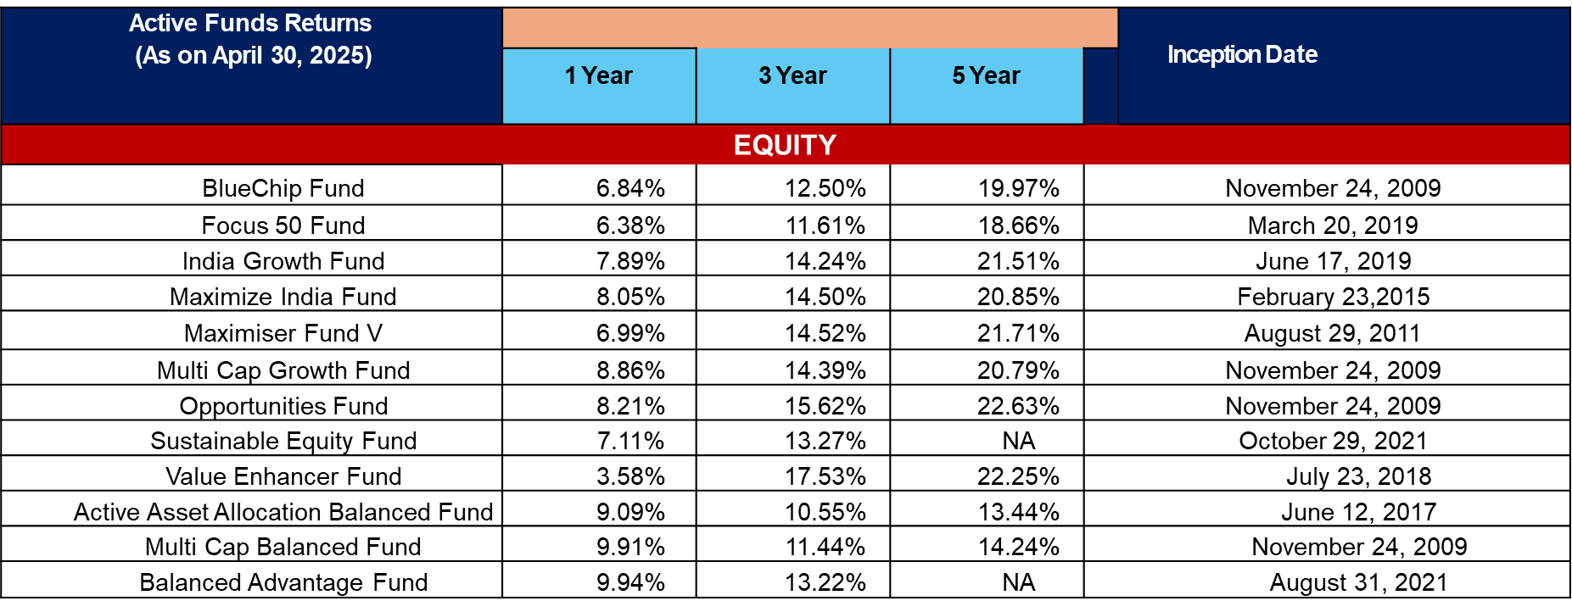
Fund Performance

Slide 15
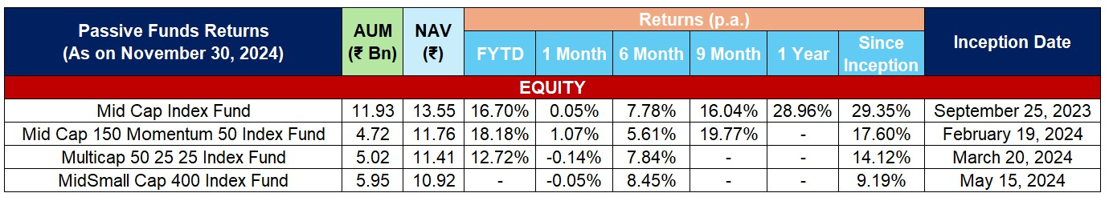
Active Funds Performance
Active Funds Returns (As on November 30, 2024) | AUM (₹ Bn) | NAV (₹) |  |  |  |  |  |  | Inception Date
 |  |  | 1 Year | 2 Year | 3 Year | 4 Year | 5 Year | Benchmark Returns
EQUITY
Maximiser V Fund | 561.5 | 52.53 | 20.50% | 15.81% | 14.97% | 18.56% | 16.15% | 13.11% | August 29, 2011
Opportunities Fund |  |  | 25.86% | 19.94% | 16.24% | 20.33% | 17.77% |  | November 24, 2009
 | 33.56 | 57.86 |  |  |  |  |  | 11.64%
Value Enhancer Fund |  |  | 39.59% | 29.41% | 18.42% | 23.10% | 20.39% |  | J uly 23, 2018
 | 80.92 | 23.64 |  |  |  |  |  | 15.64%
India Growth Fund |  |  | 23.51% | 17.63% | 14.59% | 18.93% | 17.38% |  | J une 17, 2019
 | 64.57 | 23.05 |  |  |  |  |  | 14.90%
Mid Cap Fund |  |  | 33.83% | 33.71% | - | - | - |  | September 23, 2022
 | 37.98 | 18.51 |  |  |  |  |  | 31.33%
Index Funds
Total AUM – 3.10 L Cr II Equity AUM – 1.42 L Cr*
Strictly for internal circulation only. Should not be further circulated/ used for presentation to a prospect / general public.
*(as on 31st December 2024)

Slide 16
Charge Structure
Types | Charges
Premium Allocation Charge | Zero
Policy Administration Charge | 0.25% of annual premium charged per month for Limited pay capping at ₹500 and 0.03% of Single pay premium
Fund Management Charge (per annum) | 1.35% for all Funds except 0.75% for Money Market Fund
Mortality Charges | Sum at Risk (SAR) X Applicable Mortality rates based on attained age of the LA / 1000
Partial Withdrawal Charge | Zero
Fund Switching Charge | Zero
Premium Redirection Charge | Zero
Boundary conditions
Plan Option | PPT (in years) | Policy term (in years) | Min/ Max age of LA at entry (in years) | Age at maturity (of LA) | Minimum Premium
Growth Plus | 7 | 75 minus Age at entry | Min: 0 years Max: 50 years | 75 | Monthly: ₹10,000 Yearly: ₹1,00,000
 | 8 - 9 | 75 minus Age at entry | Min: 0 years Max: 50 years | 75
 | 10 – 30 | 75 minus Age at entry | Min: 0 years | 75
 |  |  | Max: 60 years
 | Single Pay | 75 minus Age at entry | Min: 0 years | 75 | ₹ 2,50,000
 |  |  | Max: 60 years

Slide 17
How does ULIP work?
A solution to your Wealth creation & Protection needs within 1 single plan
The above illustration is for a 45 year old male opting for ICICI Pru Signature Online with an annualised premium of Rs. 10,00,000, Premium Payment term of 10 years and Policy Term of 15 years with a Life cover of 1 Cr.

Slide 18
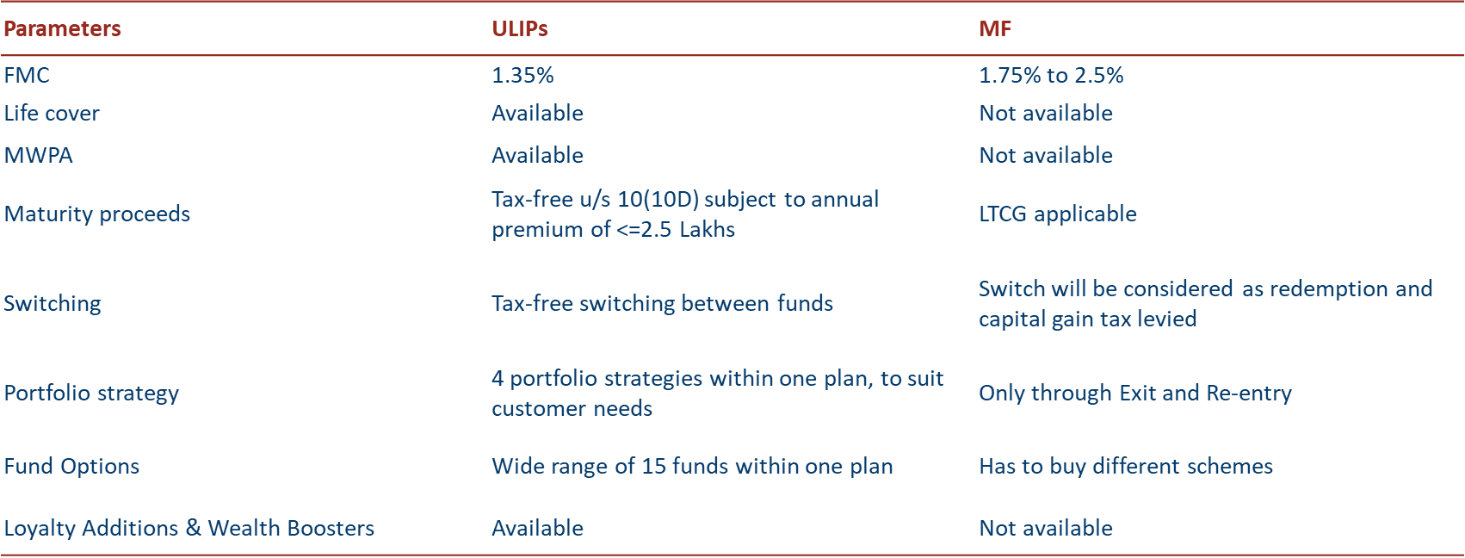
ULIP vs MF
Lesser Costs:
(Total charges under ULIPs cannot exceed 2.25% which is still lower than MF’s maximum expense ratio of 2.5%)
Better tax-efficient returns

Slide 19
Key Benefits
Key Benefits
Flexibility of investment options through various portfolio strategies
Option to choose and switch between multiple funds
Change allocation of future premium through Premium Redirection facility
Secured investment through Married Women’s Property Act
Systematic Withdrawal Plan
Grow your wealth through options like Wealth boosters and Loyalty additions
Life cover for the entire policy term, to financially secure your family
Tax benefits on premiums paid and benefits received, as per prevailing tax laws

Slide 20
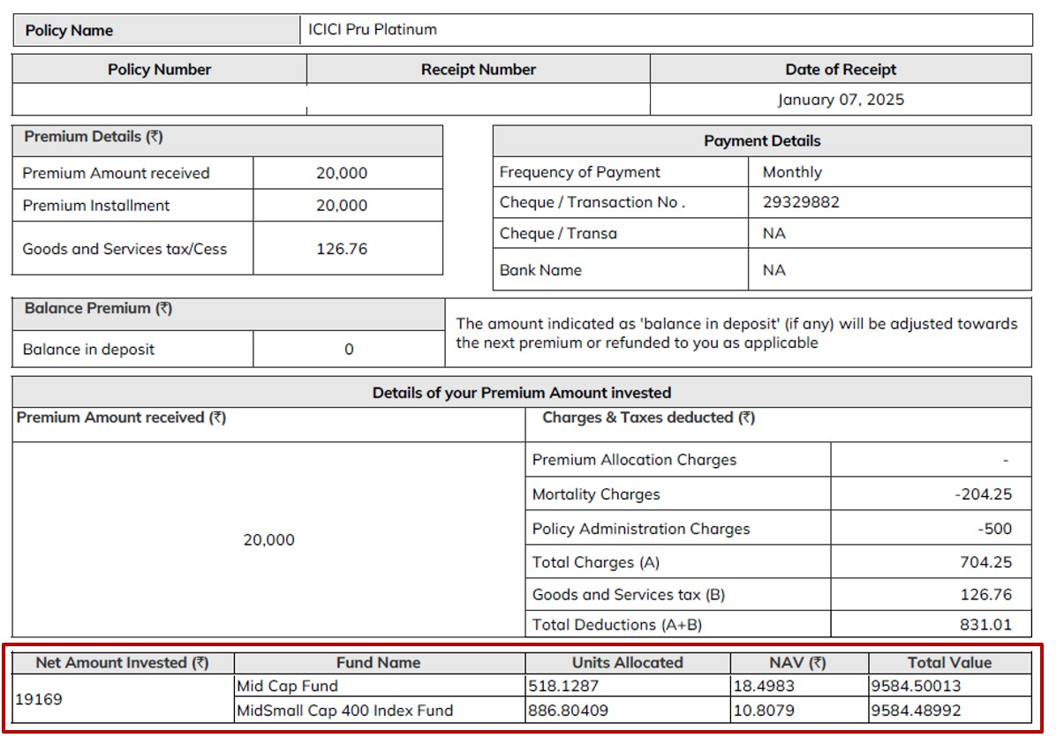
Maximum Value being Invested on Day 1
Policy Snapshot

Slide 21
Thank You
For more Info, please connect with ICICI Pru Life Team

