Slide 1

Derivatives Rollover report
September 2025
September 30, 2025

Slide 2
Index Snapshot
 | September | August | Change
NIFTY | 24725 | 24496.6 | 0.92%
NIFTY FUT OI (No of shares Cr) | 2.2 | 2.02 | 8.18%
NIFTY PCR OI | 0.81 | 0.65 | NA
BANKNIFTY | 54890.00 | 53813.40 | 1.96%
BANKNIFTY FUT OI (No of lakhs Cr) | 26.41 | 36.05 | -36.50%
BANK NIFTY PCR OI | 0.91 | 0.61 | NA
The Nifty index witnessed a volatile September month but ended positive with gains of 0.92%. The open interest at the start of expiry is greater than the previous month indicating rollover in the indices. The Nifty PCR is trading at 0.81 indicating bears are dominating at the current levels. The Bank nifty index too witnessed a volatile September month but ended with positive gains of 1.96% and the PCR is trading at 0.91 indicating a neutral stance.

Slide 3
Index Rollover
Index | June | July | August | 3M Avg | September | Cost
NIFTY | 79.53% | 75.71% | 83.63% | 79.62% | 82.60% | 0.68%
BANKNIFTY | 75.75% | 77.98% | 80.90% | 78.21% | 78.45% | 0.69%
The Nifty index witnessed an 82.60% rollover in the next series which is higher than the three-month average, indicating short positions have been carried forwards to the next series. The index remains in a sell on rise mode till the time trading below 25000 where call writers are active on monthly expiry. The Bank nifty index witnessed same rollover around the 3months average indicating some positions have been squared off in the September expiry. The index faces strong resistance at 55000 and a break above this will lead to some pull back moves towards 56000.

Slide 4
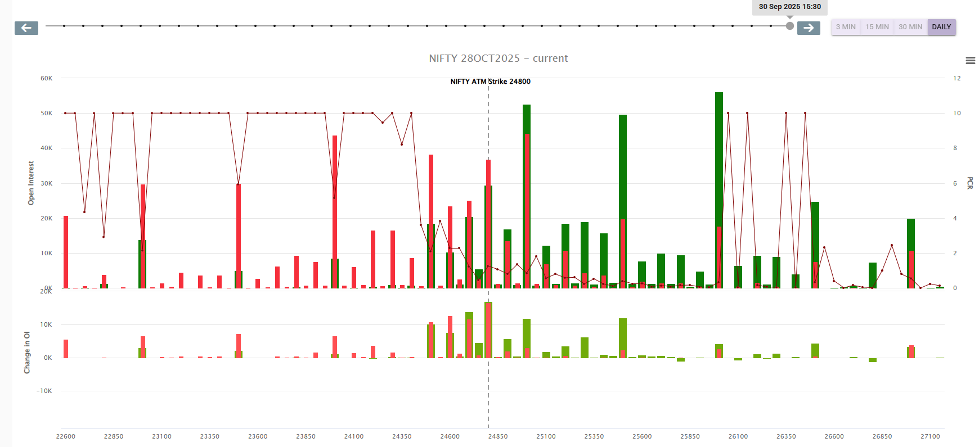
Nifty Index OI Concentration
Nifty OI Concentration (In lots) (Monthly Expiry)
Highest open interest build-up (Monthly OI)
Nifty 26000 CE resistance.
Nifty 24000 PE support.

Slide 5
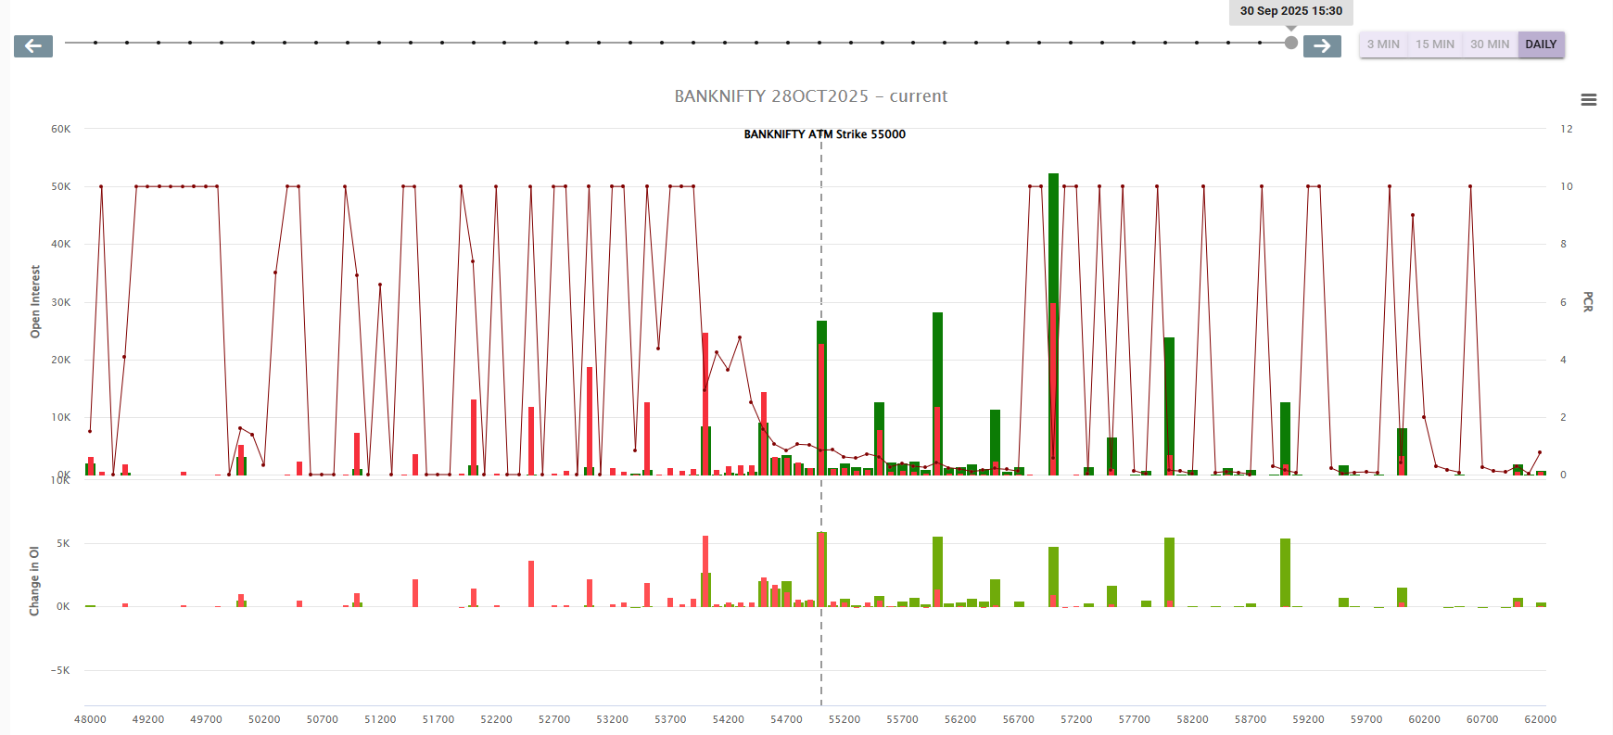
Bank Nifty Index OI Concentration
Bank Nifty OI Concentration (In lots) (Monthly Expiry)
Highest open interest build up (Monthly OI)
Bank Nifty 57000 CE
Bank Nifty 54000 PE

Slide 6
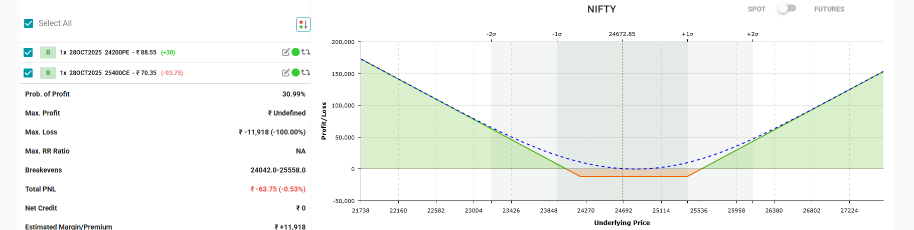
Nifty Strategy (Long Strangle)

Slide 7
Sector Rollover
High Rollover Sectors : Automobile, Banking, Finance, FMCG ,Metals, Pharma, Power
Low Rollover Sector: Cement, Textile, Chemicals

Slide 8
Top 10 Highest and lowest rollover stocks
Highest rollover | Lowest rollover
Stocks | Rollover | Cost
GRASIM | 98.82% | 14.2
HDFCBANK | 98.63% | 5.1
JSWSTEEL | 98.63% | 6.4
BHARTIARTL | 98.60% | 13.4
NESTLEIND | 98.52% | 8.8
POLICYBZR | 98.52% | 7.1
SHRIRAMFIN | 98.51% | 4.5
BAJFINANCE | 98.48% | 5.7
PATANJALI | 98.40% | 3.2
ABCAPITAL | 98.34% | 1.85
Stocks | Rollover | Cost
MARUTI | 63.58% | 80
360ONE | 64.31% | 1.6
DALBHARAT | 66.17% | 15.9
KPITTECH | 77.15% | 1.5
ANGELONE | 77.70% | 7.8
OIL | 78.92% | 2.7
BLUESTARCO | 80.18% | 5.4
GODREJCP | 78.36% | 4.8
LICI | 82.68% | 6.9
POLYCAB | 84.39% | 53.5
Top Picks: MARUTI, BAJFINANCE, JSWSTEEL.

Slide 9
Stocks Rollover
Symbol | Rollover% | Basis | 3months average
ABB | 96.21% | 36.6 | 94.89%
ABCAPITAL | 98.34% | 1.85 | 93.15%
ADANIENSOL | 97.78% | 4.45 | 96.38%
ADANIENT | 92.41% | 16.1 | 96.38%
ADANIGREEN | 95.67% | 7.9 | 93.37%
ADANIPORTS | 96.50% | 7.7 | 95.52%
ALKEM | 97.47% | 42 | 93.44%
AMBER | 93.54% | -106.5 | 91.87%
AMBUJACEM | 89.22% | 2.95 | 95.35%
ANGELONE | 77.70% | 7.8 | 81.53%
APLAPOLLO | 97.49% | 10.3 | 92.43%
APOLLOHOSP | 94.23% | 54 | 92.57%
ASHOKLEY | 93.01% | -1.7 | 95.14%
ASIANPAINT | 94.92% | 9.9 | 90.38%
ASTRAL | 91.79% | 8.1 | 94.06%
AUBANK | 95.43% | 5.35 | 57.76%
AUROPHARMA | 97.49% | 5.1 | 94.03%
AXISBANK | 96.19% | 5.6 | 94.40%
BAJAJ-AUTO | 95.33% | 46.5 | 94.72%
BAJAJFINSV | 96.25% | 14.3 | 93.71%
BAJFINANCE | 98.48% | 5.7 | 95.08%
BANDHANBNK | 98.04% | 0.76 | 97.21%
BANKBARODA | 96.26% | 1.84 | 93.72%
BANKINDIA | 96.38% | 0.96 | 94.54%
BANKNIFTY | 78.45% | 376.35 | 95.39%
BDL | 94.39% | 8.8 | 78.21%
BEL | 95.79% | 1.7 | 90.98%
BHARATFORG | 93.17% | -7.8 | 93.83%
BHARTIARTL | 98.60% | 13.4 | 90.00%
BHEL | 93.76% | 1.49 | 91.09%
BIOCON | 95.12% | 1.65 | 92.89%
BLUESTARCO | 80.18% | 5.4 | 91.29%
BOSCHLTD | 92.83% | 300 | 82.57%
BPCL | 92.90% | 1.8 | 91.82%
BRITANNIA | 97.40% | 36.5 | 81.38%
Symbol | Rollover% | basis | 3months average
BSE | 86.04% | 13 | 95.35%
CAMS | 95.43% | 25.2 | 83.22%
CANBK | 96.13% | 0.89 | 84.74%
CDSL | 93.28% | 9.9 | 90.92%
CGPOWER | 91.67% | 5.5 | 91.46%
CHOLAFIN | 95.16% | -30.1 | 92.04%
CIPLA | 93.54% | 9.5 | 92.04%
COALINDIA | 96.12% | 1.65 | 94.54%
COFORGE | 96.23% | 6.5 | 94.97%
COLPAL | 96.51% | 9.6 | 91.21%
CONCOR | 96.71% | 3.8 | 92.51%
CROMPTON | 96.52% | 1.55 | 95.17%
CUMMINSIND | 93.05% | 23.2 | 94.30%
CYIENT | 87.38% | 4.5 | 98.55%
DABUR | 95.39% | 3.2 | 89.86%
DALBHARAT | 66.17% | 15.9 | 94.21%
DELHIVERY | 93.87% | 3.4 | 96.19%
DIVISLAB | 92.70% | 38.5 | 77.96%
DIXON | 94.97% | 120 | 92.98%
DLF | 95.68% | 5.3 | 96.73%
DMART | 94.48% | -23.8 | 92.23%
DRREDDY | 94.09% | 6.3 | 93.40%
EICHERMOT | 88.21% | 51.5 | 88.22%
ETERNAL | 98.26% | 2.4 | 87.12%
EXIDEIND | 96.17% | 2.35 | 89.18%
FEDERALBNK | 96.60% | 0.99 | 94.31%
FINNIFTY | 49.27% | 193.7 | 94.42%
FORTIS | 97.77% | 3.85 | 88.73%
GAIL | 93.07% | 0.79 | 75.22%
GLENMARK | 92.49% | 8.4 | 91.40%
GMRAIRPORT | 96.60% | 0.48 | 91.67%
GODREJCP | 95.28% | 0 | 92.86%
GODREJPROP | 98.02% | 14.2 | 96.11%
GRASIM | 98.82% | 14.2 | 84.29%
HAL | 96.55% | 33.8 | 95.07%

Slide 10
Stocks Rollover
Symbol | Rollover% | basis | 3months average
HAVELLS | 95.54% | 11.2 | 97.47%
HCLTECH | 95.49% | -2.5 | 97.47%
HDFCAMC | 94.21% | 21 | 93.03%
HDFCBANK | 98.63% | 5.1 | 94.65%
HDFCLIFE | 97.76% | 5.25 | 92.85%
HEROMOTOCO | 85.63% | -25.5 | 87.81%
HFCL | 97.04% | 0.36 | 96.52%
HINDALCO | 97.15% | 5.7 | 92.52%
HINDPETRO | 85.85% | 3 | 89.45%
HINDUNILVR | 94.84% | 17.2 | 94.93%
HINDZINC | 94.69% | 2.4 | 93.61%
HUDCO | 92.68% | 1.42 | 88.28%
ICICIBANK | 98.05% | 9.5 | 89.69%
ICICIGI | 98.05% | 7.7 | 94.02%
ICICIPRULI | 96.65% | 2.5 | 92.73%
IDEA | 95.48% | 0.07 | 95.99%
IDFCFIRSTB | 97.05% | 0.47 | 92.08%
IEX | 86.14% | 0.98 | 91.50%
IGL | 95.16% | 1.33 | 97.66%
IIFL | 96.39% | 3 | 96.03%
INDHOTEL | 95.45% | 4.8 | 80.19%
INDIANB | 95.15% | -12.45 | 82.27%
INDIGO | 93.29% | 12 | 96.36%
INDUSINDBK | 96.51% | 3.35 | 92.98%
INDUSTOWER | 97.49% | 2.2 | 87.42%
INFY | 91.36% | -0.3 | 94.29%
INOXWIND | 94.56% | 0.91 | 94.29%
IOC | 95.62% | 1.03 | 90.86%
IRCTC | 96.91% | 5.05 | 96.11%
IREDA | 94.29% | 0.71 | 92.39%
IRFC | 94.67% | 0.71 | 85.17%
ITC | 96.77% | 2.85 | 82.37%
JINDALSTEL | 96.86% | 4.45 | 93.72%
JIOFIN | 94.97% | 1.95 | 93.72%
JSWENERGY | 97.00% | 2.6 | 85.23%
Symbol | Rollover% | basis | 3months average
JSWSTEEL | 98.63% | 6.4 | 87.75%
JUBLFOOD | 92.34% | 4.7 | 93.64%
KALYANKJIL | 94.61% | 3.6 | 82.62%
KAYNES | 96.19% | 49 | 94.84%
KEI | 94.97% | 22.4 | 54.02%
KFINTECH | 95.52% | 5.3 | 95.58%
KOTAKBANK | 97.42% | 12.2 | 97.08%
KPITTECH | 77.15% | 1.5 | 93.55%
LAURUSLABS | 95.58% | 5.8 | 89.82%
LICHSGFIN | 96.41% | 4.1 | 91.15%
LICI | 82.68% | 6.9 | 84.66%
LODHA | 97.22% | 8.1 | 92.95%
LT | 91.25% | 21.4 | 89.94%
LTF | 92.24% | 1.76 | 85.30%
LTIM | 96.73% | -115.5 | 88.92%
LUPIN | 96.47% | 15.2 | 76.98%
M&M | 95.92% | 25.4 | 90.16%
MANAPPURAM | 95.87% | 1.95 | 93.56%
MANKIND | 95.57% | 16.4 | 85.76%
MARICO | 96.09% | 5.15 | 95.02%
MARUTI | 63.58% | 80 | 95.16%
MAXHEALTH | 97.65% | 7.6 | 95.61%
MAZDOCK | 93.49% | 16.2 | 83.93%
MCX | 95.30% | 52 | 92.85%
MFSL | 94.02% | 8.2 | 97.10%
MIDCPNIFTY | 85.67% | 66.4 | 80.35%
MOTHERSON | 95.92% | 0.7 | 92.83%
MPHASIS | 92.77% | 16.7 | 93.05%
MUTHOOTFIN | 91.27% | 11.9 | 87.78%
NATIONALUM | 97.00% | 1.26 | 87.15%
NAUKRI | 87.30% | 8.1 | 87.18%
NBCC | 97.64% | 0.53 | 96.27%
NCC | 93.56% | 1.33 | 87.65%
NESTLEIND | 98.52% | 8.8 | 73.61%
NHPC | 93.56% | 0.53 | 89.93%

Slide 11
Stocks Rollover
Symbol | Rollover% | basis | 3months average
NIFTY | 82.60% | 167.2 | 94.18%
NIFTYNXT50 | 82.49% | 426.25 | 91.35%
NMDC | 94.84% | 0.52 | 90.99%
NTPC | 93.17% | 2.2 | 94.33%
NYKAA | 92.69% | 0.83 | 83.83%
OBEROIRLTY | 97.01% | 8.5 | 79.62%
OFSS | 91.08% | 32 | 84.11%
OIL | 78.92% | 2.7 | 90.59%
ONGC | 89.83% | 1.22 | 91.63%
PAGEIND | 92.69% | 130 | 86.01%
PATANJALI | 98.40% | 3.2 | 92.13%
PAYTM | 95.63% | 5.6 | 93.07%
PERSISTENT | 92.20% | 27.5 | 84.77%
PETRONET | 96.68% | 1.45 | 85.69%
PFC | 96.05% | 2 | 90.29%
PHOENIXLTD | 94.09% | 10.5 | 95.15%
PIDILITIND | 93.96% | 11.6 | 90.31%
PIIND | 90.10% | 13.5 | 92.49%
PNB | 96.29% | 0.89 | 94.90%
PNBHOUSING | 94.65% | 5.4 | 92.20%
POLICYBZR | 98.52% | 7.1 | 87.41%
POLYCAB | 84.39% | 53.5 | 93.85%
POWERGRID | 94.01% | 1.9 | 92.51%
PPLPHARMA | 93.37% | 0.71 | 93.91%
PRESTIGE | 91.47% | 8.4 | 89.50%
RBLBANK | 90.34% | 2.55 | 92.77%
RECLTD | 97.32% | 2.2 | 93.58%
RELIANCE | 95.80% | 9.2 | 89.82%
RVNL | 97.23% | -9.9 | 89.82%
SAIL | 97.19% | 0.92 | 85.24%
SBICARD | 96.78% | -11.7 | 91.68%
SBILIFE | 97.88% | 11.4 | 78.05%
SBIN | 90.96% | 4.5 | 94.84%
SHREECEM | 94.48% | 215 | 94.75%
SHRIRAMFIN | 98.51% | 4.5 | 91.21%
Symbol | Rollover% | basis | 3months average
SIEMENS | 95.89% | 13 | 93.47%
SOLARINDS | 96.57% | 103 | 90.82%
SONACOMS | 96.36% | 1.9 | 91.03%
SRF | 94.17% | 11.4 | 93.43%
SUNPHARMA | 93.61% | 11.3 | 89.85%
SUPREMEIND | 84.67% | 19.3 | 95.79%
SUZLON | 92.25% | 0.23 | 90.15%
SYNGENE | 96.61% | 4.15 | 91.88%
TATACHEM | 0.00% | 0 | 91.88%
TATACONSUM | 97.64% | 7.1 | 89.45%
TATAELXSI | 91.13% | -21.5 | 89.58%
TATAMOTORS | 84.77% | 3.1 | 90.76%
TATAPOWER | 96.38% | 2.6 | 95.50%
TATASTEEL | 84.57% | 1.3 | 92.27%
TATATECH | 96.27% | 4.35 | 90.20%
TCS | 93.60% | 8.8 | 59.32%
TECHM | 89.41% | 7.5 | 96.01%
TIINDIA | 97.91% | 22.1 | 92.43%
TITAGARH | 96.07% | 5.6 | 94.97%
TITAN | 96.11% | 24 | 95.81%
TORNTPHARM | 97.50% | 20.4 | 91.06%
TORNTPOWER | 91.36% | 8.7 | 93.76%
TRENT | 86.81% | 28.5 | 93.23%
TVSMOTOR | 96.34% | 25.1 | 88.22%
ULTRACEMCO | 90.26% | 61 | 88.29%
UNIONBANK | 97.41% | 0.88 | 90.90%
UNITDSPR | 95.08% | 12 | 94.36%
UNOMINDA | 98.00% | 4.1 | 92.75%
UPL | 92.63% | 4.6 | 88.49%
VBL | 91.09% | 3.25 | 92.62%
VEDL | 97.71% | 3.3 | 83.76%
VOLTAS | 95.89% | -15.7 | 94.71%
WIPRO | 96.53% | -1 | 86.81%
YESBANK | 96.28% | 0.12 | 93.45%
ZYDUSLIFE | 96.88% | 7.05 | 90.89%

Slide 12
Disclaimer
This information/document has been prepared by Sharekhan Ltd. (SHAREKHAN) and is intended for use only by the person or entity to which it is addressed to. This Document may contain confidential and/or privileged material and is not for any type of circulation and any review, retransmission, or any other use is strictly prohibited. This information/ document is subject to changes without prior notice.
Recommendation in reports based on technical and derivatives analysis is based on studying charts of a stock’s price movement, trading volume, outstanding positions, as opposed to focusing on a company’s fundamentals and as such, may not match with a report on a company’s fundamentals. However, this would only apply for information/document focused on technical and derivatives research and shall not apply to reports/documents/information focused on fundamental research.
This information/document does not constitute an offer to sell or solicitation for the purchase or sale of any financial instrument or as an official confirmation of any transaction. Though disseminated to all customers who are due to receive the same, not all customers may receive this report at the same time. SHAREKHAN will not treat recipients as customers by virtue of their receiving this information/report.
The information contained herein is obtained from publicly available data or other sources believed to be reliable and SHAREKHAN has not independently verified the accuracy and completeness of the said data and hence it should not be relied upon as such. While we would endeavour to update the information herein on reasonable basis, SHAREKHAN, its subsidiaries and associated companies, their directors and employees (“SHAREKHAN and affiliates”) are under no obligation to update or keep the information current. Also, there may be regulatory, compliance, or other reasons that may prevent SHAREKHAN and affiliates from doing so. This document is prepared for assistance only and is not intended to be and must not alone be taken as the basis for an investment decision. Recipients of this report should also be aware that past performance is not necessarily a guide to future performance and value of investments can go down as well. The user assumes the entire risk of any use made of this information. Each recipient of this document should make such investigations as it deems necessary to arrive at an independent evaluation of an investment in the securities of companies referred to in this document (including the merits and risks involved) and should consult its own advisors to determine the merits and risks of such an investment. The investment discussed or views expressed may not be suitable for all investors. We do not undertake to advise you as to any change of our views. Affiliates of Sharekhan may have issued other recommendations/ reports that are inconsistent with and reach different conclusions from the information presented in this recommendations/report.
This information/recommendation/report is not directed or intended for distribution to, or use by, any person or entity who is a citizen or resident of or located in any locality, state, country or other jurisdiction, where such distribution, publication, availability or use would be contrary to law, regulation or which would subject SHAREKHAN and affiliates to any registration or licensing requirement within such jurisdiction. The securities described herein may or may not be eligible for sale in all jurisdictions or to certain category of investors. Persons in whose possession this document may come are required to inform themselves of and to observe such restriction.
The analyst certifies that the analyst might have dealt or traded directly or indirectly in securities of the company and that all the views expressed in this document accurately reflect his or her personal views about the subject company or companies and its or their securities and do not necessarily reflect those of SHAREKHAN. The analyst and SHAREKHAN further certifies that either he or his relatives or Sharekhan associates might have direct or indirect financial interest or might have actual or beneficial ownership of 1% or more in the securities of the company at the end of the month immediately preceding the date of publication of the research report. The analyst and SHAREKHAN encourages independence in research report/ material preparation and strives to minimize conflict in preparation of research report. The analyst and SHAREKHAN does not have any material conflict of interest or has not served as officer, director or employee or engaged in market making activity of the company. The analyst and SHAREKHAN has not been a part of the team which has managed or co-managed the public offerings of the company, and no part of the analyst’s compensation was, is or will be, directly or indirectly related to specific recommendations or views expressed in this document. Sharekhan Ltd or its associates or analysts have not received any compensation for investment banking, merchant banking, brokerage services or any compensation or other benefits from the subject company or from third party in the past twelve months in connection with the research report.
Either SHAREKHAN or its affiliates or its directors or employees / representatives / clients or their relatives may have position(s), make market, act as principal or engage in transactions of purchase or sell of securities, from time to time or may be materially interested in any of the securities or related securities referred to in this report and they may have used the information set forth herein before publication. SHAREKHAN may from time to time solicit from, or perform investment banking, or other services for, any company mentioned herein. Without limiting any of the foregoing, in no event shall SHAREKHAN, any of its affiliates or any third party involved in, or related to, computing or compiling the information have any liability for any damages of any kind.
Forward-looking statements (if any) are provided to allow potential investors the opportunity to understand management’s beliefs and opinions in respect of the future so that they may use such beliefs and opinions as one factor in evaluating an investment. These statements are not a guarantee of future performance and undue reliance should not be placed on them. Such forward-looking statements necessarily involve known and unknown risks and uncertainties, which may cause actual performance and financial results in future periods to differ materially from any projections of future performance or result expressed or implied by such forward-looking statements. Sharekhan/its affiliates undertakes no obligation to update forward-looking statements if circumstances or management’s estimates or opinions should change except as required by applicable securities laws. The reader/investors are cautioned not to place undue reliance on forward-looking statements and use their independent judgement before taking any investment decision.
Investment in securities market are subject to market risks, read all the related documents carefully before investing. The securities quoted are for illustration only and are not recommendatory. Registration granted by SEBI, and certification from NISM in no way guarantee performance of the intermediary or provide any assurance of returns to investors.
Client should read the Risk Disclosure Document issued by SEBI & relevant exchanges and the T&C on www.sharekhan.com
Registered Office: 1st Floor, Tower No. 3, Equinox Business Park, LBS Marg, Off BKC, Kurla (West), Mumbai 400 070, Maharashtra, India. Tel: 022-67502000. Correspondence/Administrative Office Address - Gigaplex IT Park, Unit No 1001, 10th floor, Building No.9, TTC Industrial Area, Digha, Airoli-West, Navi Mumbai – 400708. Tel: 022 61169000 / 61150000. Registration and Contact Details: Name of Research Analyst - Sharekhan Limited - (AMFI-registered Mutual Fund Distributor), Research Analyst Regn No.: INH000006183. CIN: U99999MH1995PLC087498. SEBI Regn. Nos.: BSE / NSE (CASH / F&O / CD) / MCX - Commodity: INZ000171337; BSE – 748, NSE – 10733, MCX – 56125, DP: NSDL/CDSL-IN-DP-365-2018; PMS: INP000005786; Mutual Fund: ARN 20669 (date of initial registration: 03/07/2004, and valid till 02/07/2026); IRDAI Registered Corporate Agent (Composite) License No. CA0950, valid till June 13, 2027. Compliance Officer: Mr. Joby John Meledan; Tel: 022-4657 3809; email id: complianceofficer@sharekhan.com
For any complaints/ grievances, email us at igc@sharekhan.com, or you may even call the Customer Service desk on 022-41523200/ 022-61151111.
For any complaints/grievance, email us at igc@sharekhan.com or you may even call Customer Service desk on - 022- 41523200/022-69920600.

